Slide 1
Time Series
Time series analysis comprises methods for analyzing time series data in order to extract meaningful statistics and other characteristics of the data.
Time series forecasting is the use of a model to predict future values based on previously observed values.
Time series are widely used for non-stationary data, like economic, weather, stock price, and retail sales etc.

Slide 2
Understanding Problem Statement

Slide 3
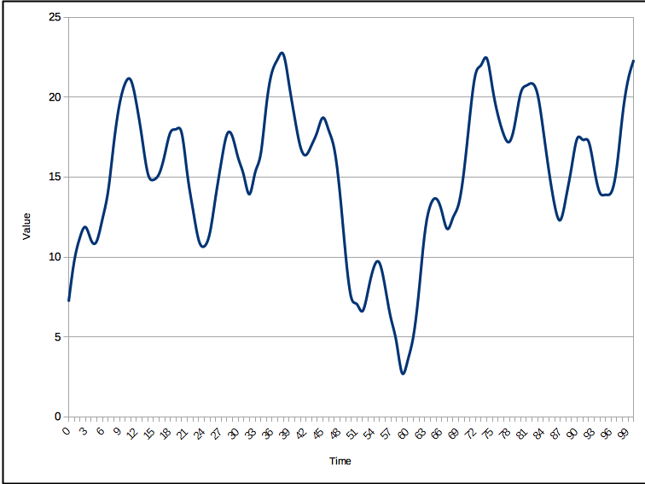
What is Time Series
Time Series is a sequence taken at successive equally placed numerical points in time.
It is a sequence of discrete time data.

Slide 4
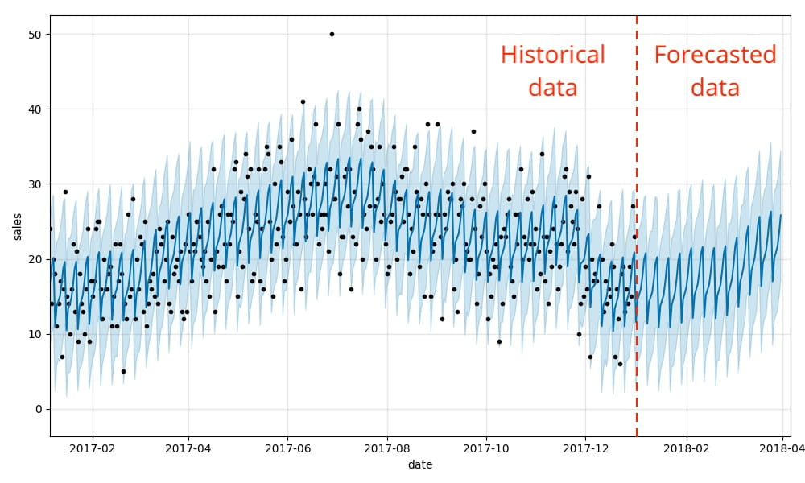
Time Series Forecasting
Time Series forecasting involves taking models fit on historical data and using them to predict future observations.
Making predictions about the future is called extrapolation in the classical statistical handling of time series data.

Slide 5
Understanding Problem
Predict the future customers in a shop.
Data contains the number of customers visiting the shop monthly from the year 1949 to 1960.
We will make use of time series models to forecast the future customers visiting the shop.

Slide 6
Treating Missing Values

Slide 7

Missing Values
Missing data or missing values are defined as the data value that is not stored for a variable in the observation of interest.
The values which are missing from the data are called missing values.

Slide 8
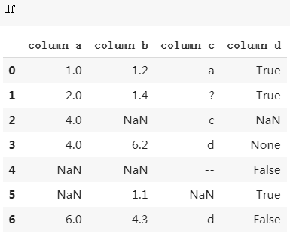
Missing Values Example
There are some NaN values in the table.
NaN value corresponds to the value which is missing from the data.

Slide 9
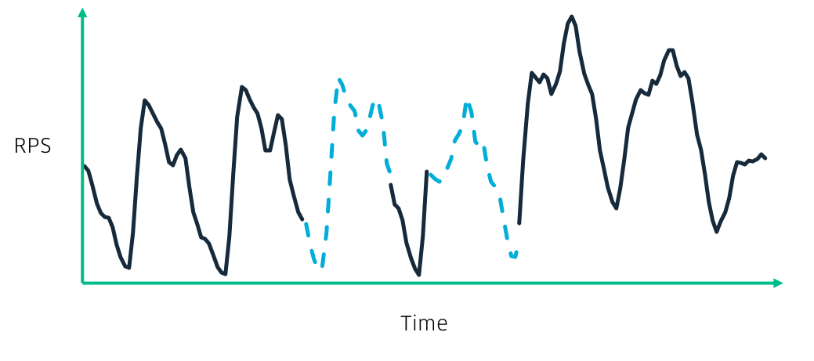
Treating Missing Values
Mean Imputation
Last Observation Carried Forward
Linear Interpolation
Seasonal Interpolation

Slide 10
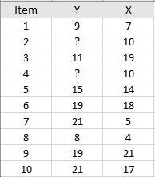
Mean Imputation
We fill the missing values by the mean of the dataset.
It can distort the seasonality of the dataset and won’t take into consideration the nature of the data.

Slide 11
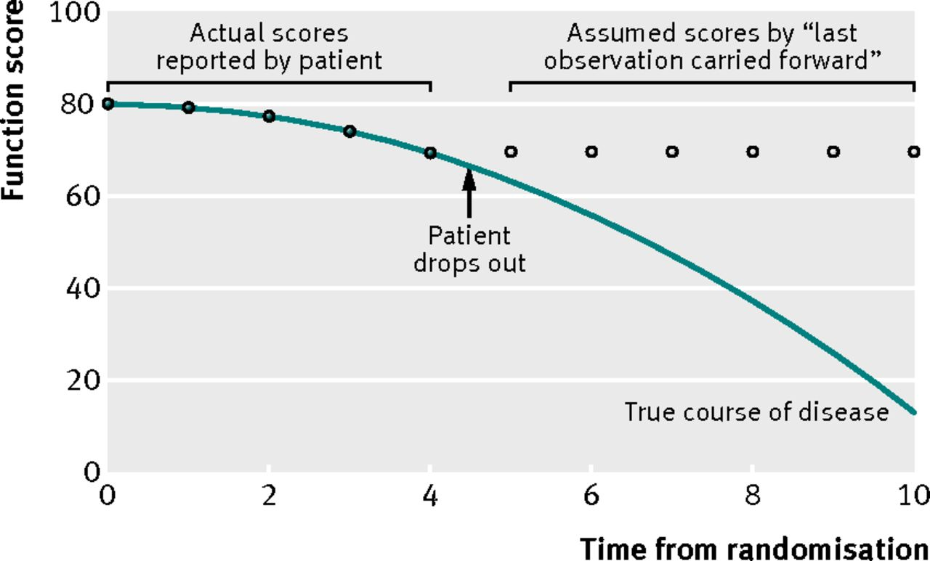
Last Observation Carried Forward(LOCF)
We impute the missing values with previous value in the data.

Slide 12
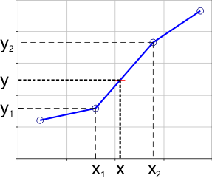
Linear Interpolation
We draw a straight line joining the previous and next points of the missing values.

Slide 13
Handling
Outliers

Slide 14

Outliers
Outliers are extreme values that fall a long way outside of the other observations.
Outliers are those values which are significantly very much different than other values present in the data.

Slide 15
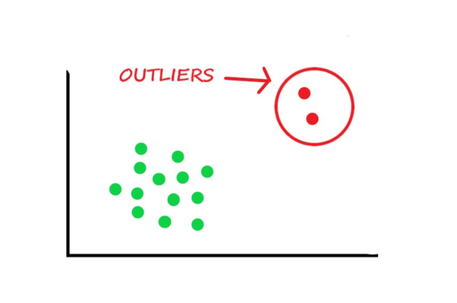
Reasons for Outliers
In the image shown, the red colored observations are the outliers of the data.
Reasons for Outliers
Entry Errors
Measurement Errors
Natural Errors

Slide 16
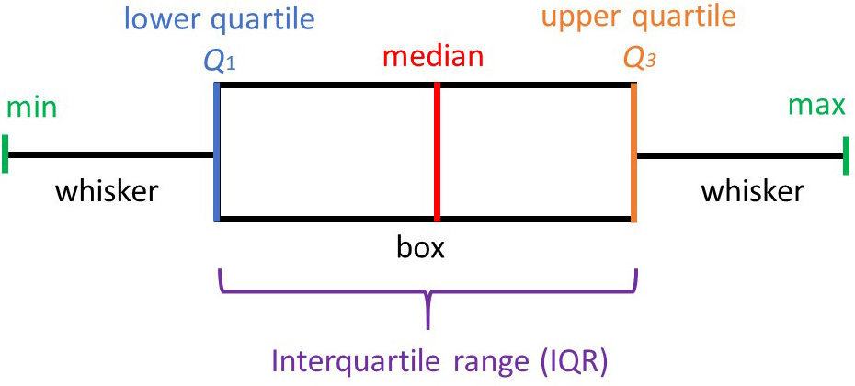
Detecting Outliers
A Boxplot is a standardized way of displaying the distribution of data.
Any data which are less than Q1-1.5*IQR or greater than Q3+1.5*IQR is considered to be outliers.
IQR- interquartile range ( Q3-Q1 )

Slide 17
Time Series Decomposition

Slide 18
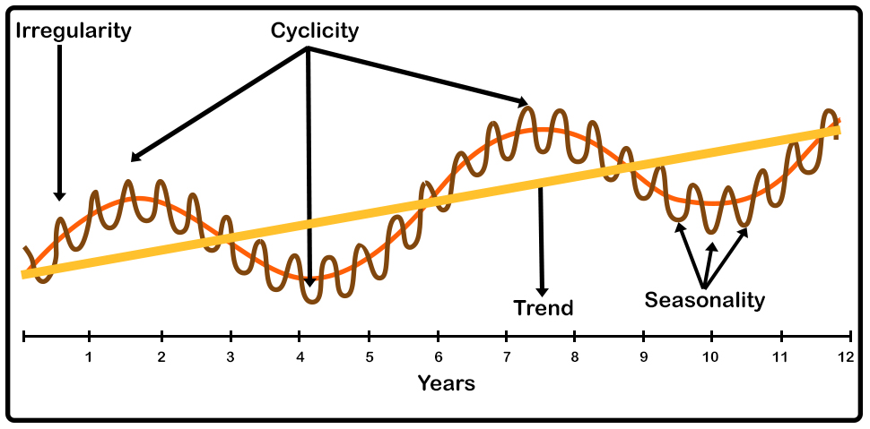
Components of Time Series
Three main components of Time Series
Level
Trend
Seasonality

Slide 19
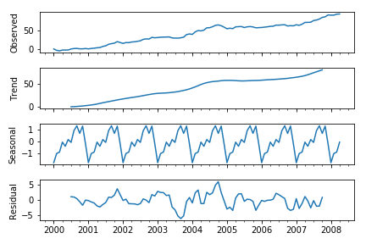
Time Series Decomposition
Time series decomposition involves thinking of a series as a combination of level, trend, seasonality, and noise components.
It provides a useful abstract model for thinking about time series and for better understanding problems during time series analysis and forecasting.

Slide 20
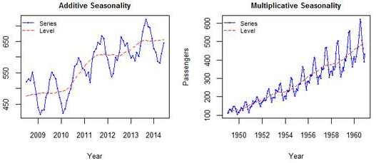
Time Series Decomposition
There are two ways of decomposing time series data:-
Additive Seasonal decomposition
Multiplicative Seasonal decomposition

Slide 21
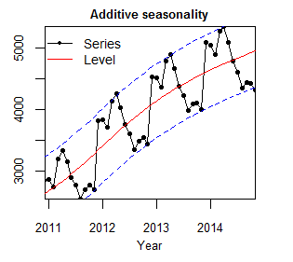
Additive Seasonal Decomposition
Additive Seasonal decomposition is when we add the individual components to get the time series data.
y(t) = Level + Trend + Seasonality + Noise

Slide 22
Multiplicative Seasonal Decomposition
Multiplicative Seasonal decomposition is when we multiply the individual components to get the time series data.
y(t) = Level * Trend * Seasonality * Noise

Slide 23
Additive vs Multiplicative Decomposition
We use additive model, the magnitude of seasonality does not vary with the level of the time series.
On the other hand, we use multiplicative models when the variation in the seasonal pattern appears to be directly proportional to the level of the time series data.

Slide 24
Holt’s Winter Exponential Smoothing

Slide 25
Holt’s Winter Exponential Smoothing
Holt’s Winter Exponential Smoothing technique is a method which includes all the three components of the time series:- level, trend and seasonality.
Holt winters is also called Triple Exponential Smoothing.
The model predicts future value by computing the combined effects of three influences.

Slide 26
Holt’s Winter Exponential Equation
The Holt’s Winter Exponential Smoothing technique equation is:-
y(t+1) = l(t) + b(t) + s(t+1-m)
m is the number of times a season repeats in a time period.

Slide 27
Assumptions of the SARIMA Model

Slide 28
Assumptions of building SARIMA model
There are two assumptions of applying the SARIMA model.
Stationarity
Autocorrelation

Slide 29
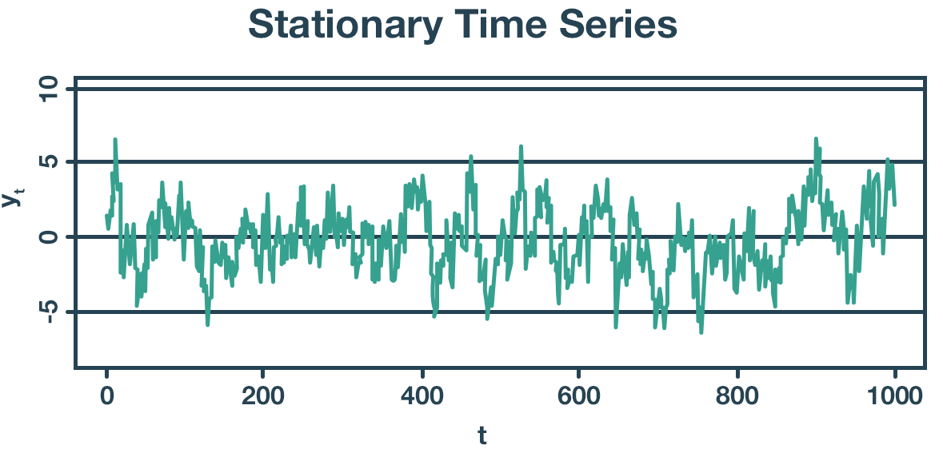
Stationarity
Stationarity means that the statistical properties of a process generating a time series do not change over time.
The statistical properties are
Mean
Variance
Covariance.

Slide 30
How to Check Stationarity?
There are two popular statistical tests using which we can test the stationarity of a time series.
Augmented Dickey-Fuller(ADF) test.
Kwiatkowski-Phillips-Schmidt-Shin (KPSS) test.

Slide 31
Ad Fuller Test vs KPSS Test
Ad Fuller Test
Null Hypothesis: The time series is not stationary.
Alternate Hypothesis: The time series is stationary.
KPSS Test
Null Hypothesis: The time series is stationary.
Alternate Hypothesis: The time series is not stationary.

Slide 32
Converting Non-stationary into Stationary
There are two tools for converting a non-stationary series into a stationary series:
Box Cox Transformation
Differencing

Slide 33
Autocorrelation
Autocorrelation is the representation of the degree of similarity between a given time series and the lagged version of itself over successive time intervals.
It helps us to know a variable is influenced by its own lagged values.

Slide 34
Types of Autocorrelation
There are two types of Autocorrelation measures:
Autocorrelation function
Partial Correlation function

Slide 35
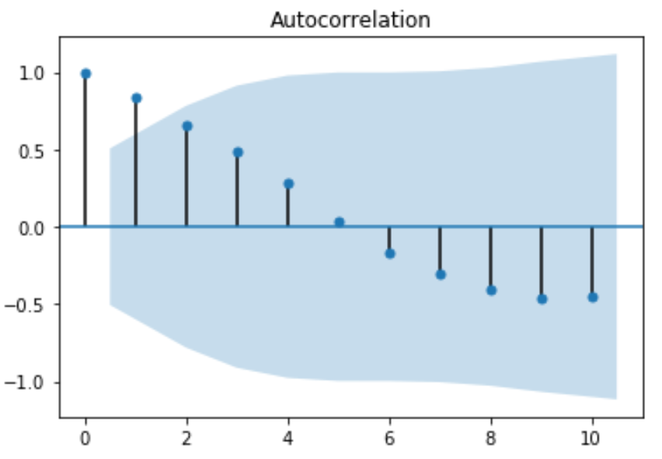
Autocorrelation function
ACF is an (complete) autocorrelation function which gives us values of auto-correlation of any series with its lagged values.

Slide 36
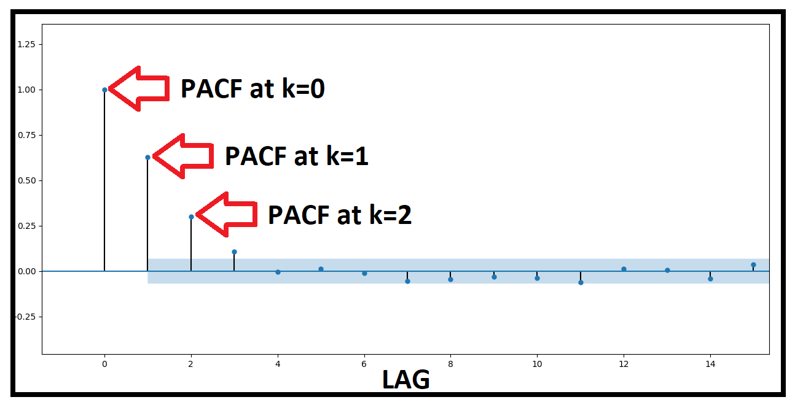
Partial Autocorrelation function
Partial autocorrelation function(PACF) gives the partial correlation of a stationary time series with its own lagged values, regressed the values of time series at all shorter lags.

Slide 37
SARIMA Model

Slide 38
Key Elements of SARIMA Model
The Time series is differenced to make it stationary.
The SARIMA equation is a linear combination of past observations and past errors.
Seasonal differencing is performed on the time series.
SARIMA models future seasonality as a linear combination of past seasonality observations and past seasonality errors.

Slide 39
Parameters of SARIMA Model
The SARIMA model has the following parameters p, q, d, m, P, Q, D
p- highest lag in the time series
q- past errors included.
d- degree of differencing to make time series stationary.
m - the number of time steps for a single seasonal period
P - the seasonal autoregressive order. 0<=P<=4
Q - the seasonal moving average order. 0<=Q<=4
D - the seasonal difference order. D=0, 1, 2

Slide 40
Major Takeaways

Slide 41
Major Takeaways
You learnt about handling missing values in the time series data.
You learnt about handling outliers present in the time series data.
You learnt about two different decompositions of time series data.
You learnt about Holt winter exponential smoothing model.
You learnt about stationary data and check stationarity of the data.

Slide 42
Major Takeaways
You learnt about the ways of converting non-stationary data to stationary data.
You learnt about autocorrelation function and partial autocorrelation function.
You learnt about implementation of the SARIMA model.
You learnt evaluating time series model.

Slide 43
Prophet Model

Slide 44
Introduction to Prophet Model
Prophet is an open source software released by Facebook’s Core Data Science Team.
It is available for download on CRAN and PyPI.
Prophet is a forecasting procedure implemented in R and Python.
It is fast and provides completely automated forecasts that can be tuned by hand by data scientists and analysts.

Slide 45

Prophet Model
Prophet is a procedure used for forecasting time series data based on an additive model where non-linear trends are fit with yearly, weekly and daily seasonality plus holiday effects.
It provides us with the ability to make time series predictions with good accuracy using simple intuitive parameters.

Slide 46
Advantages of Prophet Model
Prophet is used in many applications across Facebook for producing reliable forecasts for planning and goal setting.
Prophet is robust to outliers, missing data and dramatic changes in our time series.
It provides many possibilities for users to tweak and adjust forecasts.

Slide 47
Working of Prophet Model

Slide 48
Working of Prophet Model
The Prophet model equation is:-
y(t) = g(t) + s(t) + h(t) + є(t)
g(t) is the piecewise linear growth curve for modelling non-periodic changes in time series.
s(t) means periodic changes.
h(t) means effects of holidays.
є(t) is the error term

Slide 49
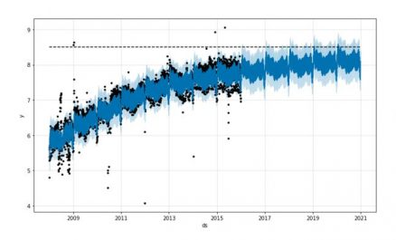
Components of Prophet Model
Trend
Trend is modelled by fitting a piecewise linear curve over the trend or non-periodic part of the time series.
The linear fitting exercise ensures that it is least affected by spikes/missing data.

Slide 50
Components of Prophet Model
Seasonality
The Seasonality s(t) provides an adaptability to the model by allowing periodic changes based on sub-daily, daily, weekly and yearly seasonality.
To fit and forecast the effects of seasonality, prophet relies on fourier series to provide a flexible model.

Slide 51
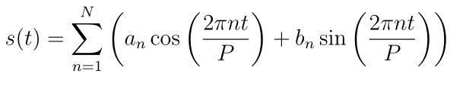
Components of Prophet Model
P is the period
The fourier order N that defines whether high frequency changes are allowed to be modelled is an important parameter to set here.

Slide 52
Fourier Series
A fourier series is a periodic function composed of harmonically related sines and cosines combined by a weighted summation.
The fourier series has many applications such as:-
Electrical engineering
Vibration analysis

Slide 53
Applications of Fourier Series
Optics
Signal processing
Image processing
Econometrics
The Fourier series of functions in the differential equation often gives some prediction about the behavior of the solution of the differential equation.

Slide 54
Components of Prophet Model
Holidays
Impact of a particular holiday on the time series is often similar year after year, making it an important incorporation into the forecast.
Holidays and events incur predictable shocks to a time series.
For instance, Diwali in India occurs on a different day each year and a large portion of the population buy a lot of new items during this period.

